Slide 1
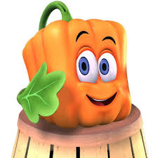
Spookley

Slide 2
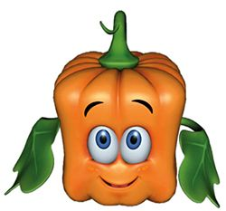
What can we do?
Wear your pumpkin to show you care
Remember that you cant judge a pumpkin for being square!
Friends are always there
Being nice shows that you care
Kindness should be everywhere

Slide 3
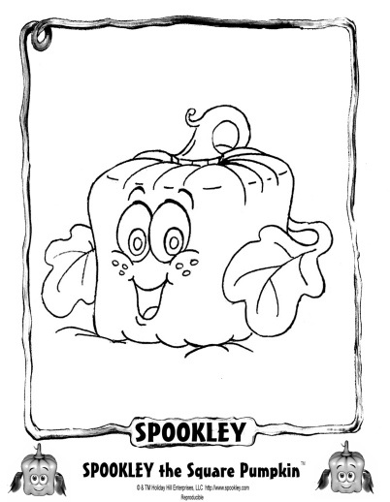
Colour him in!

Slide 4
Links
Part one
Part two
Part three
Summary of whole story

